Slide 1

A/B Testing at Scale: Accelerating Software Innovation Introduction
Ronny Kohavi, Distinguished Engineer, General Manager, Analysis and Experimentation, Microsoft
Slides at http://bit.ly/2017ABTestingTutorial

Slide 2
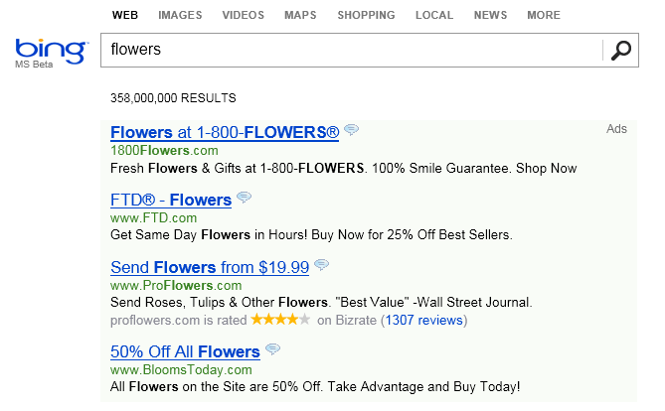
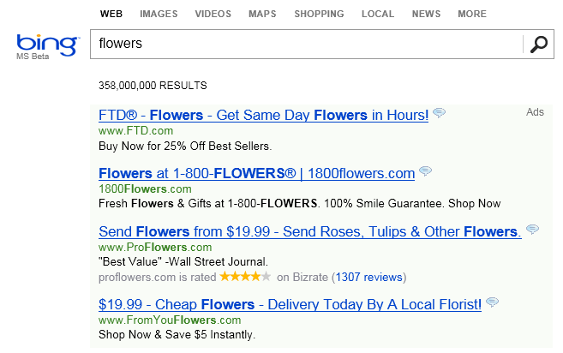
The Life of a Great Idea – True Bing Story
An idea was proposed in early 2012 to change the way ad titles were displayed on Bing
Move ad text to the title line to make it longer
Control – Existing Display
Treatment – new idea called Long Ad Titles

Slide 3
The Life of a Great Idea (cont)
…meh…
It’s one of hundreds of ideas proposed and seems
Implementation was delayed in:
Multiple features were stack-ranked as more valuable
It wasn’t clear if it was going to be done by the end of the year
An engineer thought: this is trivial to implement. He implemented the idea in a few days, and started a controlled experiment (A/B test)
An alert fired that something is wrong with revenue, as Bing was making too much money. Such alerts have been very useful to detect bugs (such as logging revenue twice)
But there was no bug. The idea increased Bing’s revenue by 12% (over $120M at the time) without hurting guardrail metrics
We are terrible at assessing the value of ideas. Few ideas generate over $100M in incremental revenue (as this idea), but the best revenue-generating idea in Bing’s history was badly rated and delayed for months!
Feb
March
April
May
June

Slide 4

We have lots of ideas to make our products better…
But not all ideas are good
It’s humbling, but most ideas are actually bad
Many times, we have to tell people that their new beautiful baby is actually…ugly
Notes:
My job is to tell people that their new brilliant baby is…actually ugly

Slide 5
It’s Hard to Assess the Value of Ideas
Features are built because teams believe they are useful but most experiments show that features fail to move the metrics they were designed to improve
Our observations based on experiments at Microsoft (paper)
1/3 of ideas were positive ideas and statistically significant
1/3 of ideas were flat: no statistically significant difference
1/3 of ideas were negative and statistically significant
References for similar observations made by many others
“Google ran approximately 12,000 randomized experiments in 2009, with [only] about 10 percent of these leading to business changes” was stated in Uncontrolled by Jim Manzi
“80% of the time you/we are wrong about what a customer wants” was stated in Experimentation and Testing: A Primer by Avinash Kaushik, author of Web Analytics and Web Analytics 2.0
QualPro tested 150,000 ideas over 22 years and founder Charles Holland stated, “75 percent of important business decisions and business improvement ideas either have no impact on performance or actually hurt performance…” in Breakthrough Business Results With MVT
At Amazon, half of the experiments failed to show improvement

Slide 6
Your Feature Reduces Churn!
You observe the churn rates for users using/not-using your feature:
25% of new users that do NOT use your feature churn (stop using product 30 days later)
10% of new users that use your feature churn
[Wrong] Conclusion: your feature reduces churn and thus critical for retention
Flaw: Relationship between the feature and retention is correlational and not causal
The feature may improve or degrade retention: the data above is insufficient for any causal conclusion
Example: Users who see error messages in Office 365 churn less. This does NOT mean we should show more error messages. They are just heavier users of Office 365
See Best Refuted Causal Claims from Observations Studies for great examples of this common analysis flaw
Use Feature
Heavy Users
Have higher retention rates

Slide 7
Example: Common Cause
Example Observation (highly stat-sig)
Palm size correlates with your life expectancy
The larger your palm, the less you will live, on average
Try it out - look at your neighbors and you’ll see who is expected to live longer
But…don’t try to bandage your hands, as there is a common cause
Women have smaller palms and live 6 years longer on average
Notes:
http://www.cbsnews.com/news/do-night-lights-cause-myopia/
http://researchnews.osu.edu/archive/nitelite.htm

Slide 8
Measure user behavior before/after ship
Flaw: This approach misses time related factors such as external events, weekends, holidays, seasonality, etc.
Oprah calls Kindle "her new favorite thing"
The new site (B) always does worse than the original (A)
Before and after example

Slide 9
A/B Tests in One Slide
Concept is trivial
Randomly split traffic between two (or more) versions
A (Control, typically existing system)
B (Treatment)
Collect metrics of interest
Analyze
A/B test is the simplest controlled experiment
A/B/n is common in practice: compare A/B/C/D, not just two variants
Equivalent names: Flights (Microsoft), 1% Tests (Google), Bucket tests (Yahoo!), Field experiments (medicine, Facebook), randomized clinical trials (RCTs, medicine)
Must run statistical tests to confirm differences are not due to chance
Best scientific way to prove causality, i.e., the changes in metrics are caused by changes introduced in the treatment(s)
Notes:
Sample of real users
Not WEIRD (Western, Educated, Industrialized, Rich, and Democratic) like many academic research samples

Slide 10
Advantages
Best scientific way to prove causality, i.e., the changes in metrics are caused by changes introduced in the treatment(s)
Two Advantages for next slides:
Sensitivity: you can detect tiny changes to metrics
Detect unexpected consequences

Slide 11
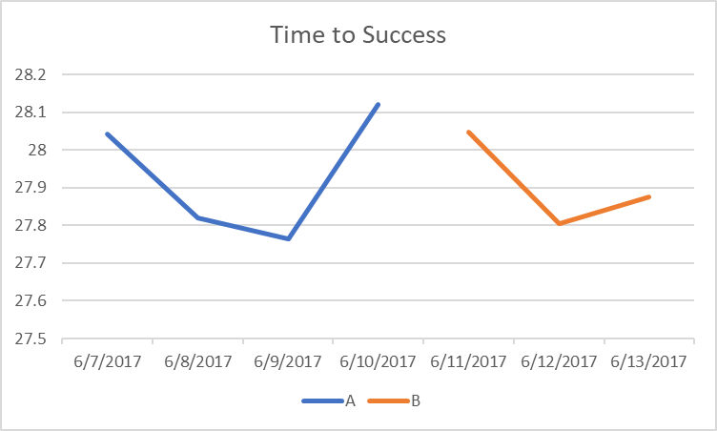
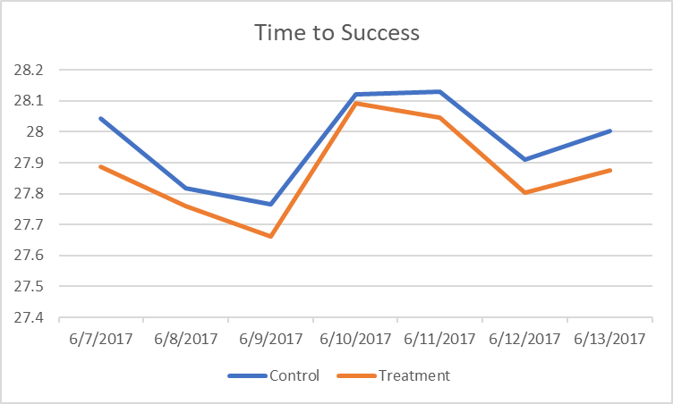
Advantage: Sensitivity!
Time-To-Success is a key metric for Bing (Time from query to a click with no quickback.)
If you ran version A, then launched a change B on 6/11/2017, could you say if it was good/bad?
But this was a controlled experiment
Treatment improved the metric by 0.32%
Could it be noise? Unlikely, p-value is 0.003 If there was no difference, the probability of observing such as change (or more extreme) is 0.003. Below 0.05 we consider stat-sig
Graph of both control/treatment (lower is better)
Notes:
http://exp/xCard/?view=8d654ac7-8a3a-473b-9e98-bc086b37d3aa

Slide 12
Why is Sensitivity Important?
Many metrics are hard to improve
Early alerting: quickly determine that something is wrong
Small degradations could accumulate
To understand the importance of performance, we slowed Bing server in a controlled experiment
One of the key insights:
An engineer that improves server performance by 4msec more than pays for his/her fully-loaded annual costs
Features cannot ship if they degrade performance by a few msec unexpectedly

Slide 13
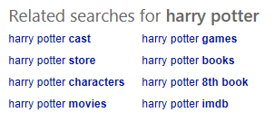
Advantage: Unexpected Consequences
It is common for a change to have unexpected consequences
Example, Bing has a related search block
A small change to the block (say bolding of terms)
Changes the click rate to the block (intended effect)
But that causes the distribution of queries to change
And some queries monetize better/worse than others, so revenue is impacted
A typical Bing scorecard has 2,000+ metrics, so that when something unexpected changes, it will be highlighted

Slide 14
Real Examples
Three experiments that ran at Microsoft
Each provides interesting lessons
All had enough users for statistical validity
For each experiment, we provide the OEC, the Overall Evaluation Criterion
This is the criterion to determine which variant is the winner
Let’s see how many you get right
Everyone please stand up
You will be given three options and you will answer by raising you left hand, right hand, or leave both hand down (details per example)
If you get it wrong, please sit down
Since there are 3 choices for each question, random guessing implies 100%/3^3 =~ 4% will get all three questions right. Let’s see how much better than random we can get in this room
Notes:
- Good Boss, Bad Boss: How to Be the Best... and Learn from the Worst by Robert I. Sutton
Most people suffer from “self-enhancement bias” and believe they are better than the rest—and they have a hard time accepting or remembering contrary facts.
One study showed, for example, that 90 percent of drivers believe they have above-average driving skills.

Slide 15


Windows Search Box
The search box is in the lower left part of the taskbar for most of the 500M machines running Windows 10
Here are two variants:
OEC (Overall Evaluation Criterion): user engagement--more searches (and thus Bing revenue)
Raise your left hand if you think the Left version wins (stat-sig)
Raise your right hand if you think the Right version wins (stat-sig)
Don’t raise your hand if they are the about the same
Notes:
500M is public from http://www.computerworld.com/article/3195802/microsoft-windows/microsoft-now-claims-half-a-billion-windows-10-devices.html
I saw “most” because some minimize it, and windows 10 includes non-desktop PCs (xbox, phones).

Slide 16
Windows Search Box (cont)
Intentionally left blank
Notes:
500M is public from http://www.computerworld.com/article/3195802/microsoft-windows/microsoft-now-claims-half-a-billion-windows-10-devices.html
I saw “most” because some minimize it, and windows 10 includes non-desktop PCs (xbox, phones).

Slide 17
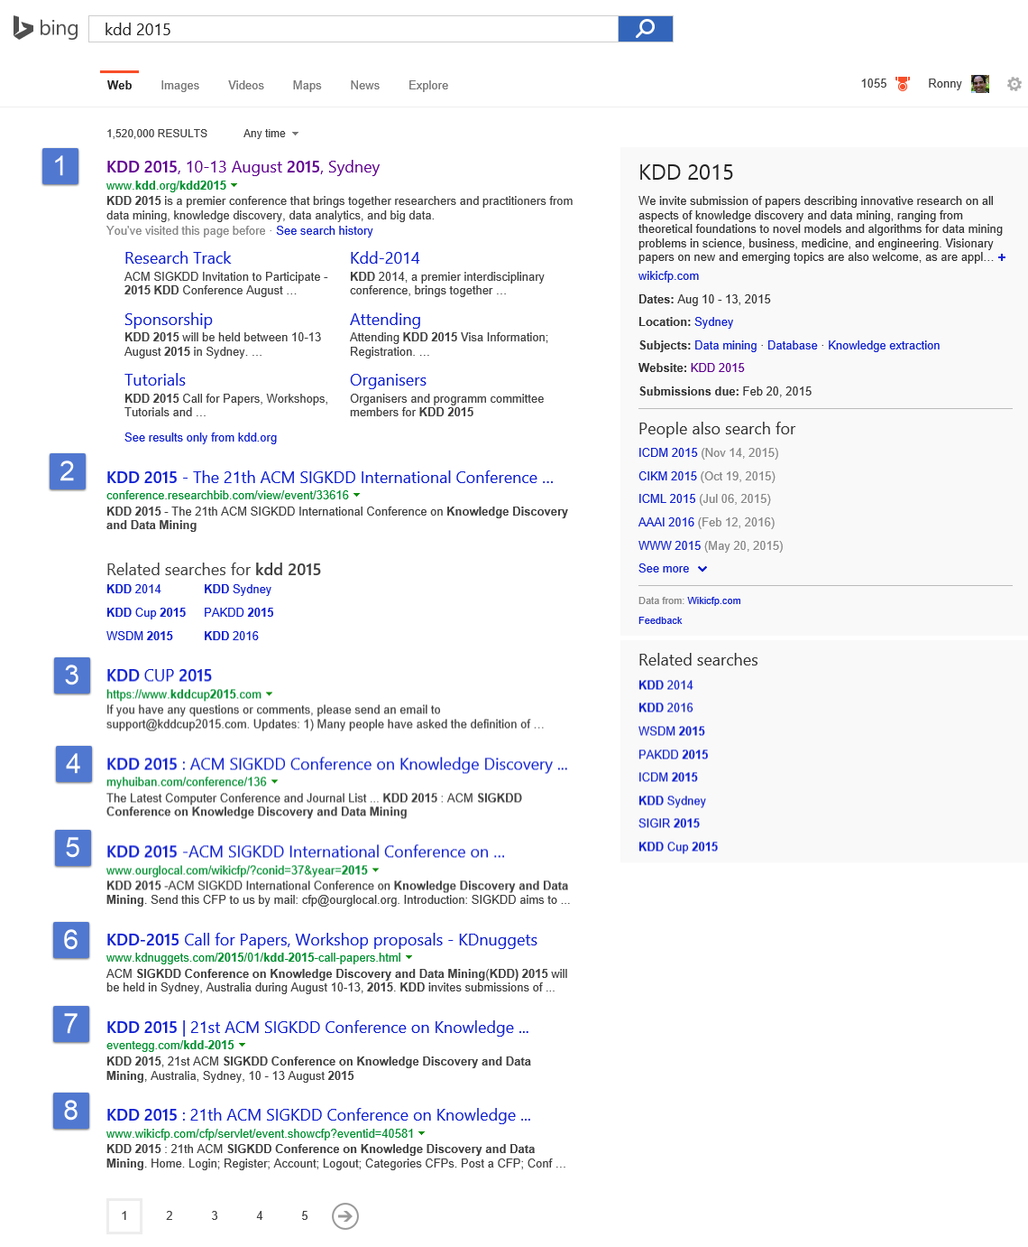
Example 2: SERP Truncation
SERP is a Search Engine Result Page (shown on the right)
OEC: Clickthrough Rate on 1st SERP per query (ignore issues with click/back, page 2, etc.)
Version A: show 10 algorithmic results
Version B: show 8 algorithmic results by removing the last two results
All else same: task pane, ads, related searches, etc.
Version B is slightly faster (fewer results means less HTML, but server-side computed same set)
Raise your left hand if you think A Wins (10 results)
Raise your right hand if you think B Wins (8 results)
Don’t raise your hand if they are the about the same

Slide 18
SERP Truncation
Intentionally left blank

Slide 19
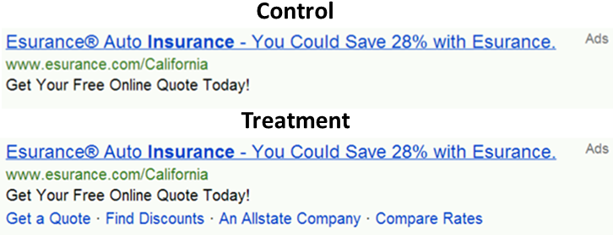
Example 3: Bing Ads with Site Links
Should Bing add “site links” to ads, which allow advertisers to offer several destinations on ads?
OEC: Revenue, ads constraint to same vertical pixels on avg
Pro adding: richer ads, users better informed where they land
Cons: Constraint means on average 4 “A” ads vs. 3 “B” ads Variant B is 5msc slower (compute + higher page weight)
Raise your left hand if you think Left version wins
Raise your right hand if you think Right version wins
Don’t raise your hand if they are the about the same

Slide 20
Bing Ads with Site Links
Intentionally left blank

Slide 21
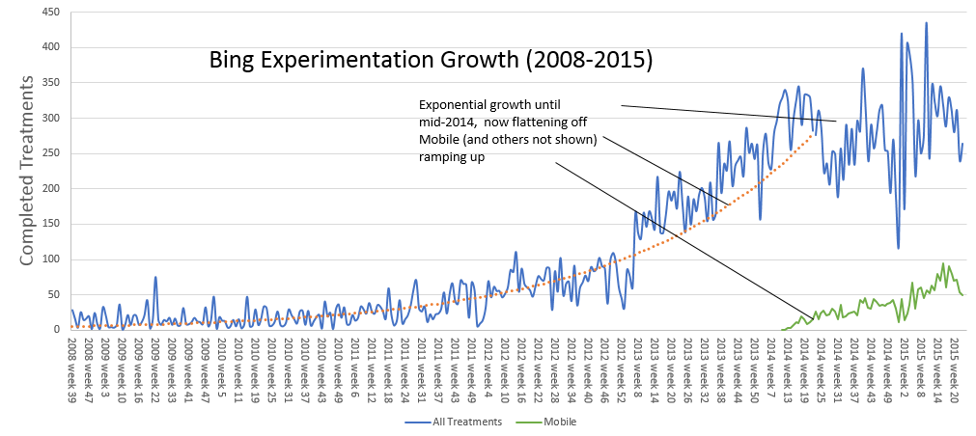
Bing - Experimentation at Scale
Bing runs over 1,000 experiment treatments per month
Typical treatment is exposed to millions of users, sometimes tens of millions.
There is no single Bing. Since a user is exposed to over 15 concurrent experiments, they get one of 5^15 = 30 billion variants (debugging takes a new meaning)
Until 2014, the system was limiting usage as it scaled. Now limits come from engineers’ ability to code new ideas
In the last year, ExP generated 250,000 scorecards
(weekly)
Notes:
Video shows scorecard at https://www.youtube.com/watch?v=SiPtRjiCe4U&t=105

Slide 22
Bing Ads Revenue per Search^{(*)} – Inch by Inch
Emarketer estimates Bing revenue grew 55% from 2014 to 2016 (not official statement)
About every month a “package” is shipped, the result of many experiments
Improvements are typically small (sometimes lower revenue, impacted by space budget)
Seasonality (note Dec spikes) and other changes (e.g., algo relevance) have large impact
Feb lift:
-1.2%
Aug Lift: 1.4%
Oct lift: 1.9%
Apr lift: 1%
Oct :lift 0.15%
June lift:
1.1%
Jan lift: 2.5%
May lift: 0.6%
Aug lift:
4.2%
Mar lift: 0.2%
Jul lift: 2.2%
Jul lift: -0.6%
Rollback/ cleanup
Sept lift: 1.6%
July lift: 2.6%
Aug lift: 8.6%
Oct: lift:
6.1%
Mar lift: 3.6%
May lift:
0.5%
Nov lift:
3.6%
Jan lift: -3.1%
June lift:
1.05%
New models:
0.1%
Feb lift:
0.9%
Apr lift: 2.5%
Sep lift:
1.4%
Sep lift :
6.8%
New models: 0.2%
(*) Numbers have been perturbed for obvious reasons
Notes:
Emarketer: (2.94-1.90)/1.9 = 54.7%

Slide 23
Pitfall 1: Failing to agree on a good Overall Evaluation Criterion (OEC)
The biggest issues with teams that start to experiment is making sure they
Agree what they are optimizing for
Agree on measurable short-term metrics that predict the long-term value (and hard to game)
Microsoft support example with time on site
Bing example
Bing optimizes for long-term query share (% of queries in market) and long-term revenue. Short term it’s easy to make money by showing more ads, but we know it increases abandonment. Revenue is a constraint optimization problem: given an agreed avg pixels/query, optimize revenue
Queries/user may seem like a good metric, but degrading results will cause users to search more. Sessions/user is a much better metric (see http://bit.ly/expPuzzling). Bing modifies its OEC every year as our understanding improves. We still don’t have a good way to measure “instant answers,” where users don’t click
Notes:
You can fill the page with ads, which is what happened with the early search engines

Slide 24
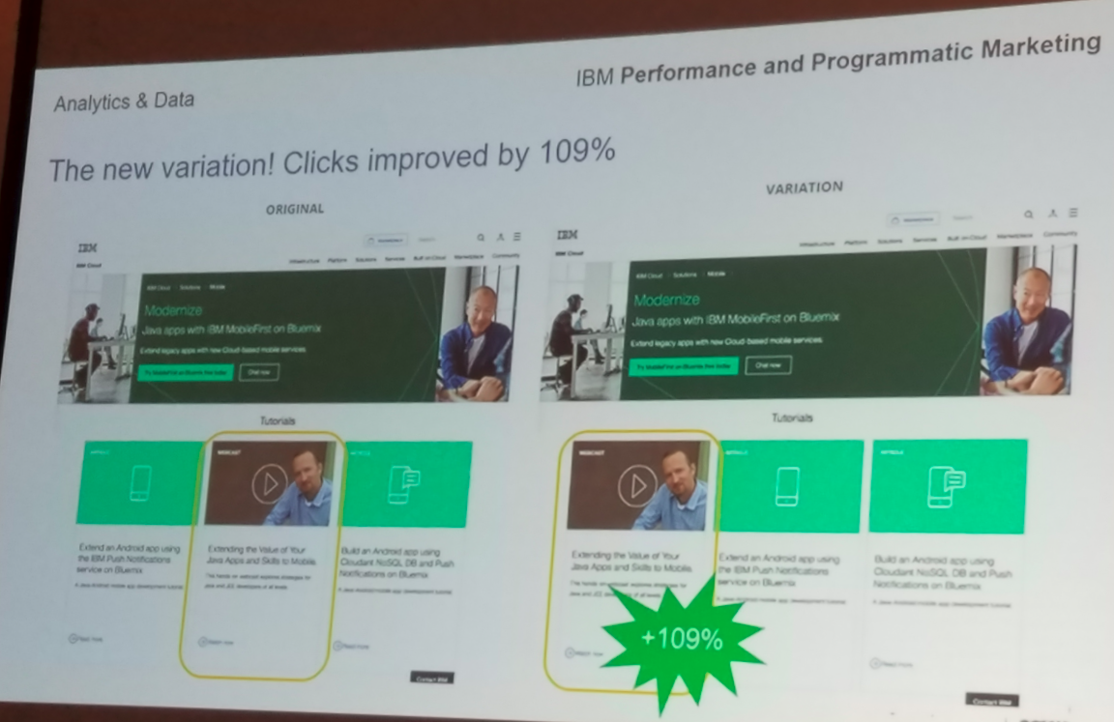
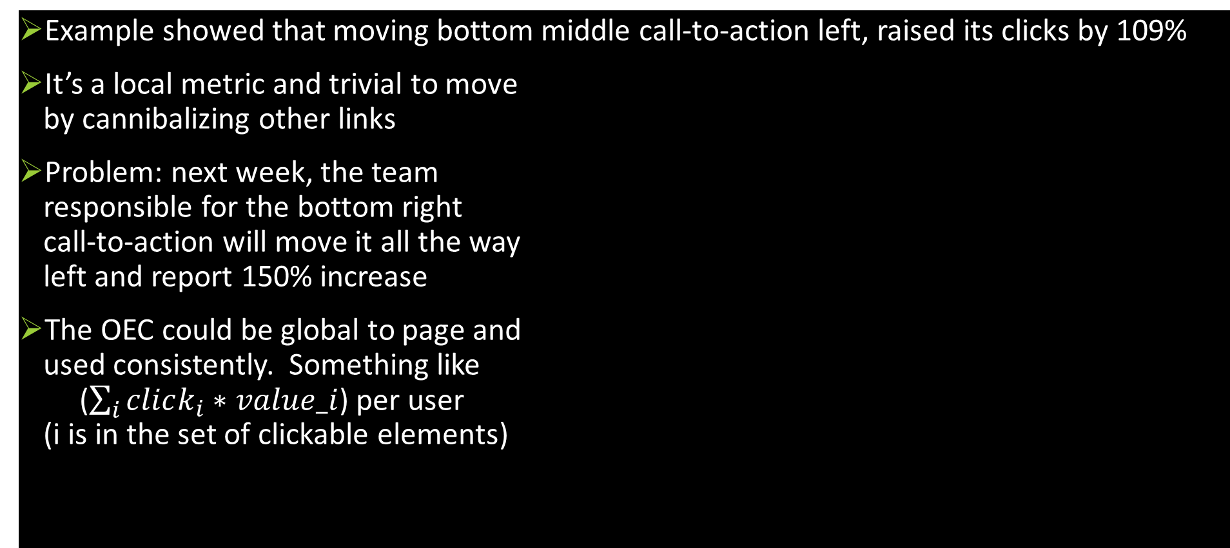
Example of Bad OEC
Example showed that moving bottom middle call-to-action left, raised its clicks by 109%
It’s a local metric and trivial to move by cannibalizing other links
Problem: next week, the team responsible for the bottom right call-to-action will move it all the way left and report 150% increase
The OEC could be global to page and used consistently. Something like ($\sum_{i}{click_{i}∗value_i}$) per user (i is in the set of clickable elements)

Slide 25
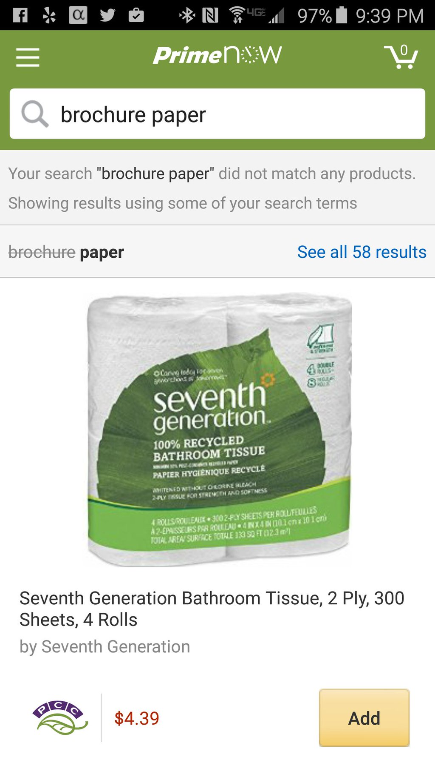
Bad OEC Example
Your data scientists makes an observation: 2% of queries end up with “No results.”
Manager: must reduce. Assigns a team to minimize “no results” metric
Metric improves, but results for query brochure paper are crap (or in this case, paper to clean crap)
Sometimes it *is* better to show “No Results.” This is a good example of gaming the OEC.
Real example from my Amazon Prime now search https://twitter.com/ronnyk/status/713949552823263234
Notes:
@@Dev: if you’re wrong, it’s often clear: crashes.
Here: if the OEC is wrong, it’s hard to tell. MetricsLab, degradation flights. Tufte’s talk. Human behavior is not rocket science, it’s harder.
Point to Alex’s paper

Slide 26
Pitfall 2: Misinterpreting P-values
NHST = Null Hypothesis Statistical Testing, the “standard” model commonly used
P-value <= 0.05 is the “standard” for rejecting the Null hypothesis
P-value is often mis-interpreted. Here are some incorrect statements from Steve Goodman’s A Dirty Dozen
If P = .05, the null hypothesis has only a 5% chance of being true
A non-significant difference (e.g., P >.05) means there is no difference between groups
P = .05 means that we have observed data that would occur only 5% of the time under the null hypothesis
P = .05 means that if you reject the null hyp, the probability of a type I error (false positive) is only 5%
The problem is that p-value gives us Prob (X >= x | H_0), whereas what we want is Prob (H_0 | X = x)
Notes:
A Dirty Dozen: Twelve P-Value Misconceptionsby Steven Goodman
#1: the null hypothesis is ASSUMED to be true, so clearly p-value can’t say anything about its probability directly. Must use Bayes Rule.
#2: the null effect is consistent with the observed. We may not have enough data to reject the null
#3: the p-value is seeing the observed value plus more EXTREME
#4: same as #1
Note that I’m both flipping the conditional and also changing from tail (X>=x) to (X=x).
Related to local false discovery rate: http://statweb.stanford.edu/~ckirby/brad/papers/2005LocalFDR.pdf

Slide 27
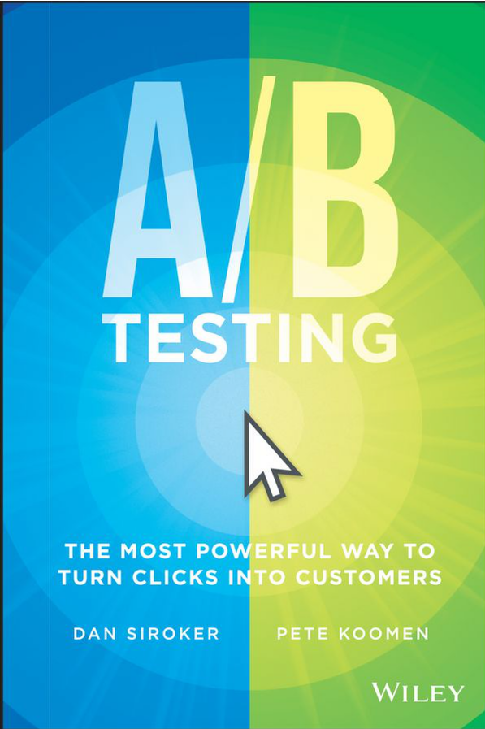
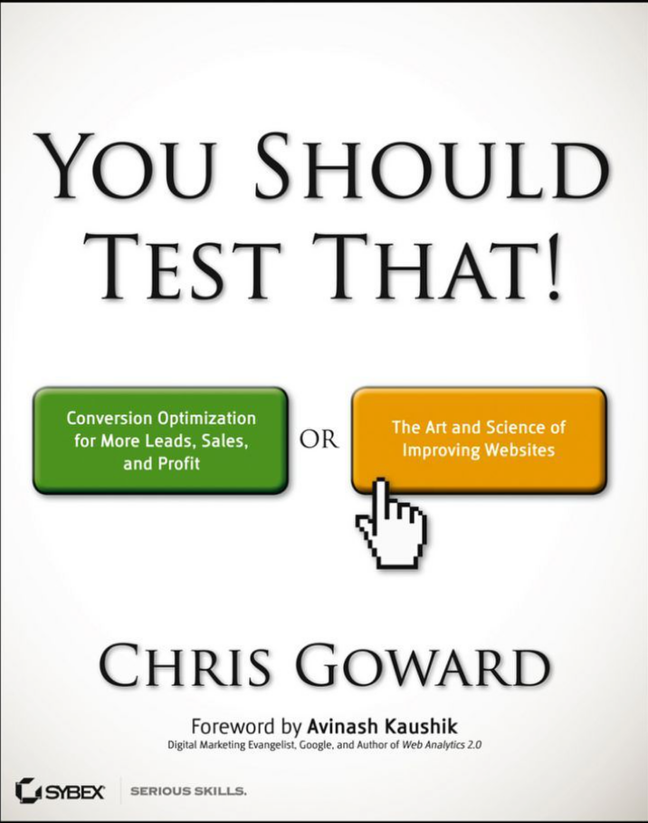
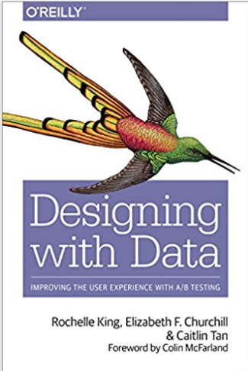
Pitfall 3: Failing to Validate the Experimentation System
Software that shows p-values with many digits of precision leads users to trust it, but the statistics or implementation behind it could be buggy
Getting numbers is easy; getting numbers you can trust is hard
Example: Two very good books on A/B testing get the stats wrong (see Amazon reviews). The recent book on Designing with Data also gets some wrong
Recommendation:
Run A/A tests: if the system is operating correctly, the system should find a stat-sig difference only about 5% of the time
Do a Sample-Ratio-Mismatch test. Example
Design calls for equal percentages to Control Treatment
Real example: Actual is 821,588 vs. 815,482 users, a 50.2% ratio instead of 50.0%
Something is wrong! Stop analyzing the result. The p-value for such a split is 1.8e-6, so this should be rarer than 1 in 500,000.
SRMs happens to us every week!
Notes:
More examples:
webcache hit rate changes
mobile clicks (instrumentation bugs)
click loss (open in new tab)
- PLT improves: if you click in new tab before page loaded, those PLT that are excluded are larger
Books: A/B Testing from Optimizely founders Dan Siroker and Peter Koomen; and
You Should Test That by WiderFunnel’s CEO Chris Goward

Slide 28
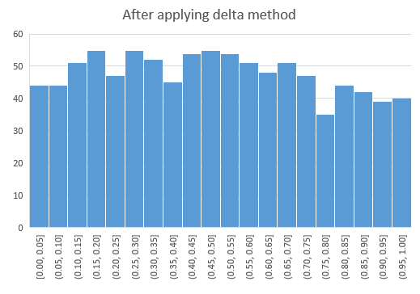
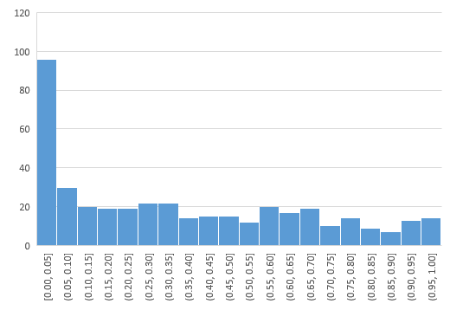
Example A/A test
P-value distribution for metrics in A/A tests should be uniform
Do 1,000 A/A tests, and check if the distribution is uniform
When we got this for some Skype metrics, we had to correct things

Slide 29
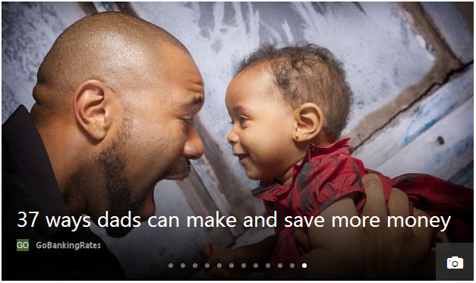
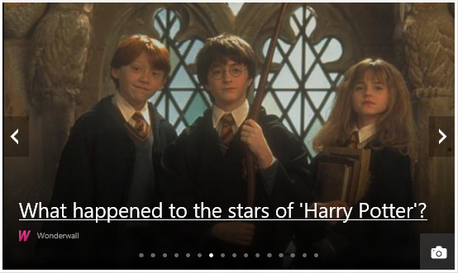


MSN Experiment: Add More Infopane Slides
The infopane is the “hero” image at MSN, and it auto rotates between slides with manual option
Control: 12 slides
Treatment: 16 slides
Control was much better than treatment for engagement (clicks, page views)
Notes:
MSN shows 12 slides in the Infopane, whereas the competitors including Yahoo and AOL have order of magnitude more slides in theirs. So the hypothesis was that if we were to increase the number of slides in the Infopane we can get a better Today CTR as well as increase the Network PV/Clicks.

Slide 30
MSN Experiment: SRM
Except… there was a sample-ratio-mismatch with fewer users in treatment (49.8% instead of 50.0%)
Can anyone think of a reason?
User engagement increased so much for so many users, that the heaviest users were being classified as bots and removed
After fixing the issue, the SRM went away, and the treatment was much better

Slide 31
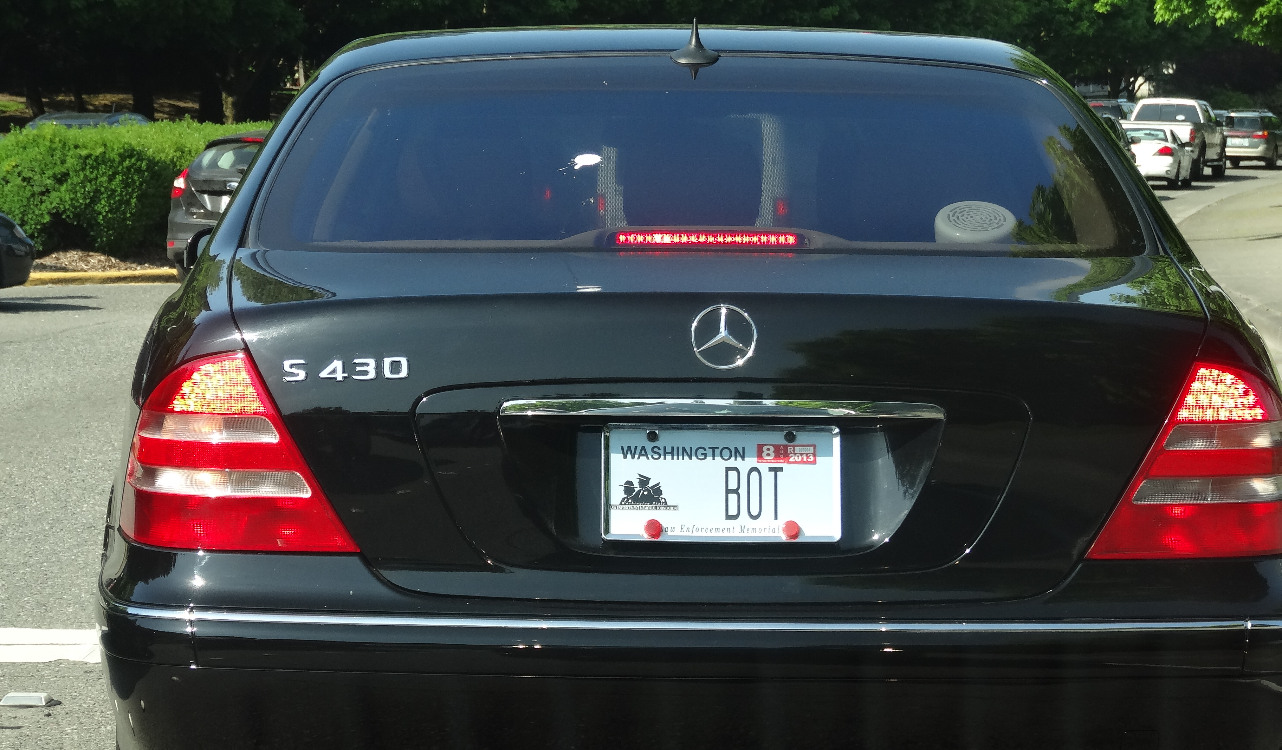

Pitfall 4: Failing to Validate Data Quality
Outliers create significant skew: enough to cause a false stat-sig result
Example:
An experiment treatment with 100,000 users on Amazon, where 2% convert with an average of $30. Total revenue = 100,000*2%*$30 = $60,000. A lift of 2% is $1,200
Sometimes (rarely) a “user” purchases double the lift amount, or around $2,500. That single user who falls into Control or Treatment is enough to significantly skew the result.
The discovery: libraries purchase books irregularly and order a lot each time
Solution: cap the attribute value of single users to the 99th percentile of the distribution
Example:
Bots at Bing sometimes issue many queries
Over 50% of Bing traffic is currently identified as non-human (bot) traffic!
Notes:
Negative times. Skype calls times of “days.”
Plot all univariate distributions
MSN added slides to slide show, caused more clicks, classified as bots. Reverse result. SRM

Slide 32
The Best Data Scientists are Skeptics
The most common bias is to accept good results and investigate bad results. When something is too good to be true, remember Twyman
In the book Exploring Data: An Introduction to Data Analysis for Social Scientists, the authors wrote that Twyman’s law is “perhaps the most important single law in the whole of data analysis."
Twyman’s law Any figure that looks interesting or different is usually wrong
http://bit.ly/twymanLaw

Slide 33
The Cultural Challenge
It is difficult to get a man to understand something when his salary depends upon his not understanding it. -- Upton Sinclair
Why people/orgs avoid controlled experiments
Some believe it threatens their job as decision makers
At Microsoft, program managers select the next set of features to develop. Proposing several alternatives and admitting you don’t know which is best is hard
Editors and designers get paid to select a great design
Failures of ideas may hurt image and professional standing. It’s easier to declare success when the feature launches
We’ve heard: “we know what to do. It’s in our DNA,” and “why don’t we just do the right thing?”
The next few slides show a four-step cultural progression towards becoming data-driven

Slide 34
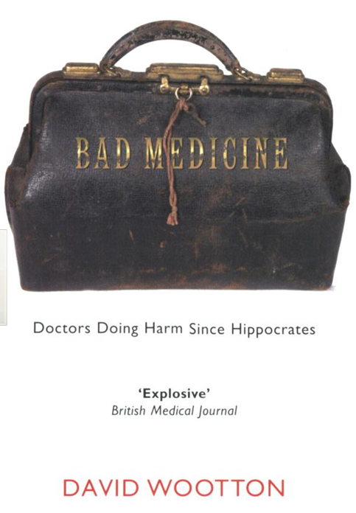
Cultural Stage 1: Hubris
Experimentation is the least arrogant method of gaining knowledge
—Isaac Asimov
Stage 1: we know what to do and we’re sure of it
True story from 1849
John Snow claimed that Cholera was caused by polluted water, although prevailing theory at the time was that it was caused by miasma: bad air
A landlord dismissed his tenants’ complaints that their water stank
Even when Cholera was frequent among the tenants
One day he drank a glass of his tenants’ water to show there was nothing wrong with it
He died three days later
That’s hubris. Even if we’re sure of our ideas, evaluate them

Slide 35
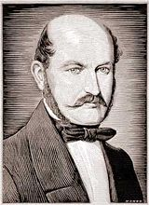
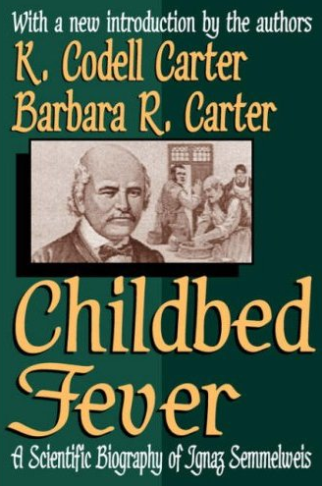
Cultural Stage 2: Insight through Measurement and Control
Semmelweis worked at Vienna’s General Hospital, an important teaching/research hospital, in the 1830s-40s
In 19th-century Europe, childbed fever killed more than a million women
Measurement: the mortality rate for women giving birth was
15% in his ward, staffed by doctors and students
2% in the ward at the hospital, attended by midwives
Notes:
Collecting stats is the first phase – instrument, measure

Slide 36
Cultural Stage 2: Insight through Measurement and Control
He tries to control all differences
Birthing positions, ventilation, diet, even the way laundry was done
He was away for 4 months and death rate fell significantly when he was away. Could it be related to him?
Insight:
Doctors were performing autopsies each morning on cadavers
Conjecture: particles (called germs today) were being transmitted to healthy patients on the hands of the physicians
He experiments with cleansing agents
Chlorine and lime was effective: death rate fell from 18% to 1%

Slide 37
Cultural Stage 3: Semmelweis Reflex
Success? No! Disbelief. Where/what are these particles?
Semmelweis was dropped from his post at the hospital
He goes to Hungary and reduced mortality rate in obstetrics to 0.85%
His student published a paper about the success. The editor wrote
We believe that this chlorine-washing theory has long outlived its usefulness… It is time we are no longer to be deceived by this theory
In 1865, he suffered a nervous breakdown and was beaten at a mental hospital, where he died
Semmelweis Reflex is a reflex-like rejection of new knowledge because it contradicts entrenched norms, beliefs or paradigms
Only in 1800s? No! A 2005 study: inadequate hand washing is one of the prime contributors to the 2 million health-care-associated infections and 90,000 related deaths annually in the United States

Slide 38
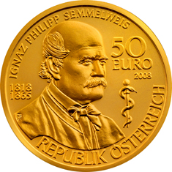
Cultural Stage 4: Fundamental Understanding
In 1879, Louis Pasteur showed the presence of Streptococcus in the blood of women with child fever
2008, 143 years after he died, a 50 Euro coin commemorating Semmelweis was issued

Slide 39
Summary: Evolve the Culture
Hubris
Measure and Control
Accept Results avoid Semmelweis Reflex
Fundamental Understanding
Hippos kill more humans than any other (non-human) mammal (really)
In many areas we’re in the 1800s in terms of our understanding, so controlled experiments can help
First in doing the right thing, even if we don’t understand the fundamentals
Then developing the underlying fundamental theories

Slide 40
Maturity Model in Experimentation
Enabling experimentation in large software products is challenging
The experimentation platform capabilities is only one piece of the puzzle
Other aspects include:
Data quality: instrumentation, pipelines, monitoring
Integration of experimentation into team’s software development process
Ability to clearly specify and measure product’s long-term goals (OEC)
Development of experimentation knowledge and expertise within the team
Cultural buy-in
We developed a model to describe this process and provide step-by-step guidance in The Evolution of Continuous Experimentation

Slide 41
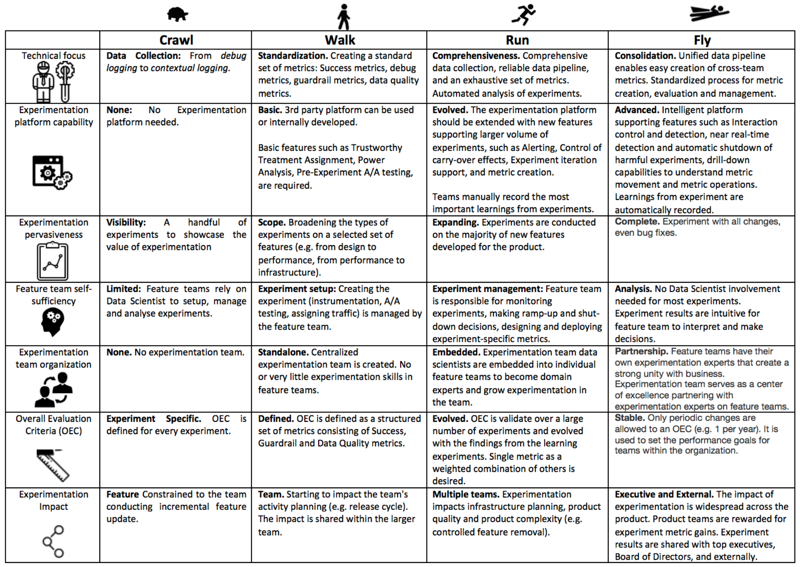

Slide 42
Ethics
Controversial examples
Facebook ran an emotional contagion experiment (editorial commentary)
Amazon ran a pricing experiment
OK Cupid (matching site) modified the “match” score to deceive users who they believed matched at 30% so it showed 90%
Resources
1979 Belmont Report
1991 Federal “Common Rule” and Protection of Human Subjects Key concept: Minimal Risk: the probability and magnitude of harm or discomfort anticipated in the research are not greater in and of themselves than those ordinarily encountered in daily life or during the performance of routine physical or psychological examinations or tests
When in doubt, use an IRB: Institutional Review Board

Slide 43

The HiPPO
HiPPO = Highest Paid Person’s Opinion
Fact: Hippos kill more humans than any other (non-human) mammal
Listen to the customers and don’t let the HiPPO kill good ideas
There is a box with HiPPOs and booklets with selected papers for you to take

Slide 44
Summary
The less data, the stronger the opinions
Think about the OEC. Make sure the org agrees what to optimize
It is hard to assess the value of ideas
Listen to your customers – Get the data
Prepare to be humbled: data trumps intuition. Cultural challenges.
Compute the statistics carefully
Getting numbers is easy. Getting a number you can trust is harder
Experiment often
Triple your experiment rate and you triple your success (and failure) rate. Fail fast & often in order to succeed
Accelerate innovation by lowering the cost of experimenting
See http://exp-platform.com for papers

Slide 45
Additional Slides

Slide 46
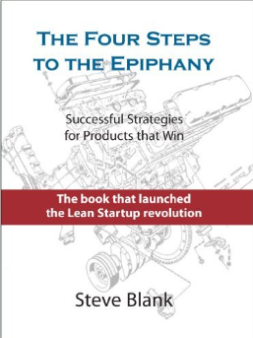
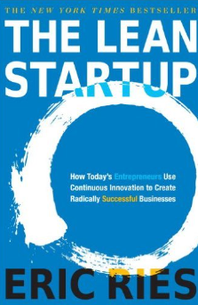
Motivation: Product Development
It doesn't matter how beautiful your theory is, it doesn't matter how smart you are. If it doesn't agree with experiment[s], it's wrong -- Richard Feynman
Classical software development: spec->dev->test->release
Customer-driven Development: Build->Measure->Learn (continuous deployment cycles)
Described in Steve Blank’s The Four Steps to the Epiphany (2005)
Popularized by Eric Ries’ The Lean Startup (2011)
Build a Minimum Viable Product (MVP), or feature, cheaply
Evaluate it with real users in a controlled experiment (e.g., A/B test)
Iterate (or pivot) based on learnings
Why use Customer-driven Development? Because we are poor at assessing the value of our ideas (more about this later in the talk)
Why I love controlled experiments
In many data mining scenarios, interesting discoveries are made and promptly ignored. In customer-driven development, the mining of data from the controlled experiments and insight generation is part of the critical path to the product release
Notes:
Classical software dev
Program management writes the spec for the next revision of the product
Software developers implement the spec
Testers validate the software against the spec
Software is released
Also see In Praise of Continuous Deployment: The WordPress.com Story,” May 19, 2010
http://toni.org/2010/05/19/in-praise-of-continuous-deployment-the-wordpress-com-story/ and Berkun, Scott (2013-08-20). The Year Without Pants: WordPress.com and the Future of Work (p. 117). Wiley. Kindle Edition.

Slide 47
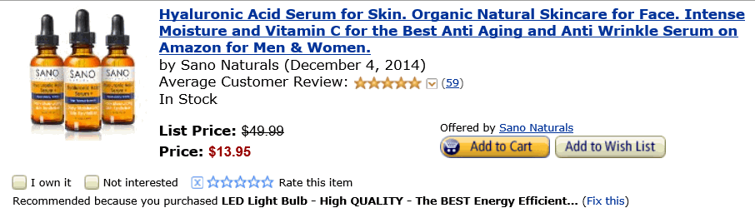


Personalized Correlated Recommendations
Actual personalized recommendations from Amazon. (I was director of data mining and personalization at Amazon back in 2003, so I can ridicule my work.)
Buy anti aging serum because you bought an LED light bulb (Maybe the wrinkles show?)
Buy Atonement movie DVD because you bought a Maglite flashlight (must be a dark movie)
Buy Organic Virgin Olive Oil because you bought Toilet Paper. (If there is causality here, it’s probably in the other direction.)

Slide 48
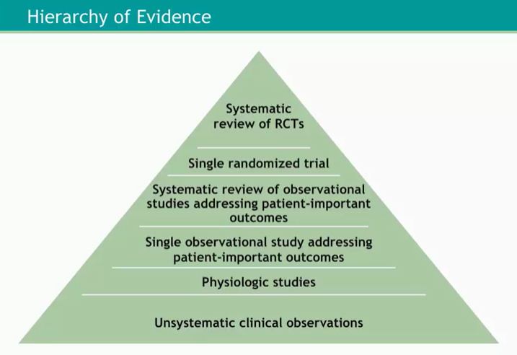
Hierarchy of Evidence and Observational Studies
All claims are not created equally
Observational studies are UNcontrolled studies
Be very skeptical about unsystematic studies or single observational studies
The table on the right is from a Coursera lecture: Are Randomized Clinical Trials Still the Gold Standard?
At the top are the most trustworthy
Controlled Experiments (e.g., RCT randomized clinical trials)
Even higher: multiple RCTs—replicated results
See http://bit.ly/refutedCausalClaims
Notes:
See also GRADE
Series intro: http://www.jclinepi.com/article/S0895-4356(10)00329-X/fulltext
http://www.jclinepi.com/article/S0895-4356(10)00330-6/fulltext
http://www.jclinepi.com/article/S0895-4356(10)00332-X/fulltext

Slide 49
Advantage of Controlled Experiments
Controlled experiments test for causal relationships, not simply correlations
When the variants run concurrently, only two things could explain a change in metrics:
The “feature(s)” (A vs. B)
Random chance
Everything else happening affects both the variants
For #2, we conduct statistical tests for significance
The gold standard in science and the only way to prove efficacy of drugs in FDA drug tests
Controlled experiments are not the panacea for everything. Issues discussed in the journal survey paper (http://bit.ly/expSurvey)

Slide 50
Systematic Studies of Observational Studies
Jim Manzi in the book Uncontrolled summarized papers by Ioannidis showing that
90 percent of large randomized experiments produced results that stood up to replication, as compared to only 20 percent of nonrandomized studies
Young and Carr looked at 52 claims made in medical observational studies, which were grouped into 12 claims of beneficial treatments (Vitamin E, beta-carotene, Low Fat, Vitamin D, Calcium, etc.)
These were not random observational studies, but ones that had follow-on controlled experiments (RCTs)
NONE (zero) of the claims replicated in RCTs, 5 claims were stat-sig in the opposite direction in the RCT
Their summary Any claim coming from an observational study is most likely to be wrong

Slide 51
The Experimentation Platform
Experimentation Platform provides full experiment-lifecycle management
Experimenter sets up experiment (several design templates) and hits “Start”
Pre-experiment “gates” have to pass (specific to team, such as perf test, basic correctness)
System finds a good split to control/treatment (“seedfinder”). Tries hundreds of splits, evaluates them on last week of data, picks the best
System initiates experiment at low percentage and/or at a single Data Center. Computes near-real-time “cheap” metric and aborts in 15 minutes if there is a problem
System wait for several hours and computes more metrics. If guardrails are crossed, auto shut down; otherwise, ramps-up to desired percentage (e.g., 20% of users for each variant)
After a day, system computes many more metrics (e.g., thousand+) and sends e-mail alerts about interesting movements (e.g., time-to-success on browser-X is down D%)
Notes:
Video shows scorecard at https://www.youtube.com/watch?v=SiPtRjiCe4U&t=105

Slide 52
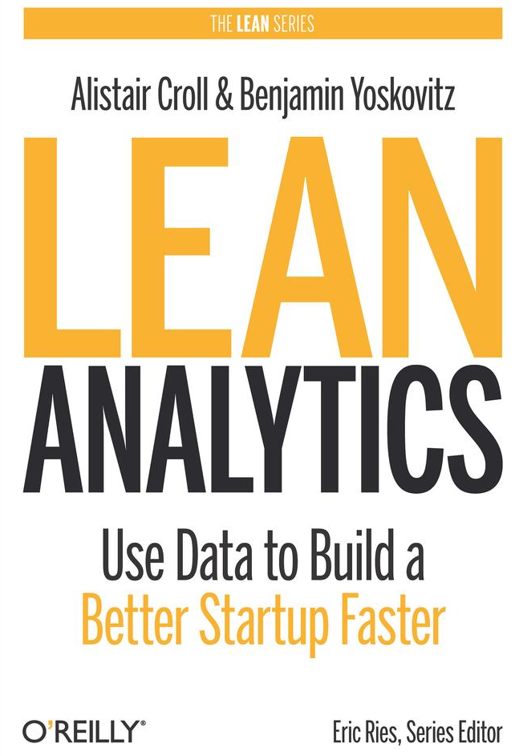
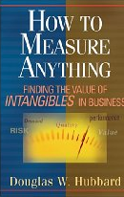


The OEC
If you remember one thing from this talk, remember this point
OEC = Overall Evaluation Criterion
Lean Analytics call it OMTM: One Metric That Matters (OMTM).
Getting agreement on the OEC in the org is a huge step forward
Suggestion: optimize for customer lifetime value, not short-term revenue. Ex: Amazon e-mail Look for success indicators/leading indicators, avoid lagging indicators and vanity metrics.
Read Doug Hubbard’s How to Measure Anything
Funnels use Pirate metrics: acquisition, activation, retention, revenue, and referral — AARRR
Criterion could be weighted sum of factors, such as
Conversion/action, Time to action, Visit frequency
Use a few KEY metrics. Beware of the Otis Redding problem (Pfeffer & Sutton) “I can’t do what ten people tell me to do, so I guess I’ll remain the same.”
Report many other metrics for diagnostics, i.e., to understand the why the OEC changed, and raise new hypotheses to iterate. For example, clickthrough by area of page
See KDD 2015 papers by Henning etal. on Focusing on the Long-term: It’s Good for Users and Business, and Kirill etal. on Extreme States Distribution Decomposition Method
Agree early on what you are optimizing
Notes:
Amazon E-mail example:
One of my teams at Amazon was sending e-mails. The metric they used was profit (from sales) generated by e-mail. But that’s a terrible metric, as it’s monotonically increasing with spam, which led to customer complaints. The team then imposed a constrained of sending K e-mails per week and built a whole optimization system around this, but it was a big wasted effort. The right approach is to define a better OEC: subtract the cost of unsubscribes (customer future liftetime value from e-mail). Once that was added, half the e-mail programs were negative.
you might think that firms would recognize the commonsense wisdom expressed in a line from Otis Redding’s song “Sitting by the Dock of the Bay” on the need for fewer, focused measurements: “Can’t do what ten people tell me to do, so I guess I’ll remain the same.”
Pfeffer, Jeffrey; Sutton, Robert I. (1999-10-05). The Knowing-Doing Gap: How Smart Companies Turn Knowledge into Action (Kindle Locations 2077-2079). Harvard Business Review Press. Kindle Edition.
Pirate Metrics — a term coined by venture capitalist Dave McClure: a startup needs to watch into acquisition, activation, retention, revenue, and referral — AARRR.’’
http://www.slideshare.net/dmc500hats/startup-metrics-for-pirates-long-version

Slide 53
OEC for Search
KDD 2012 Paper: Trustworthy Online Controlled Experiments: Five Puzzling Outcomes Explained
Search engines (Bing, Google) are evaluated on query share (distinct queries) and revenue as long-term goals
Puzzle
A ranking bug in an experiment resulted in very poor search results
Degraded (algorithmic) search results cause users to search more to complete their task, and ads appear more relevant
Distinct queries went up over 10%, and revenue went up over 30%
What metrics should be in the OEC for a search engine?

Slide 54
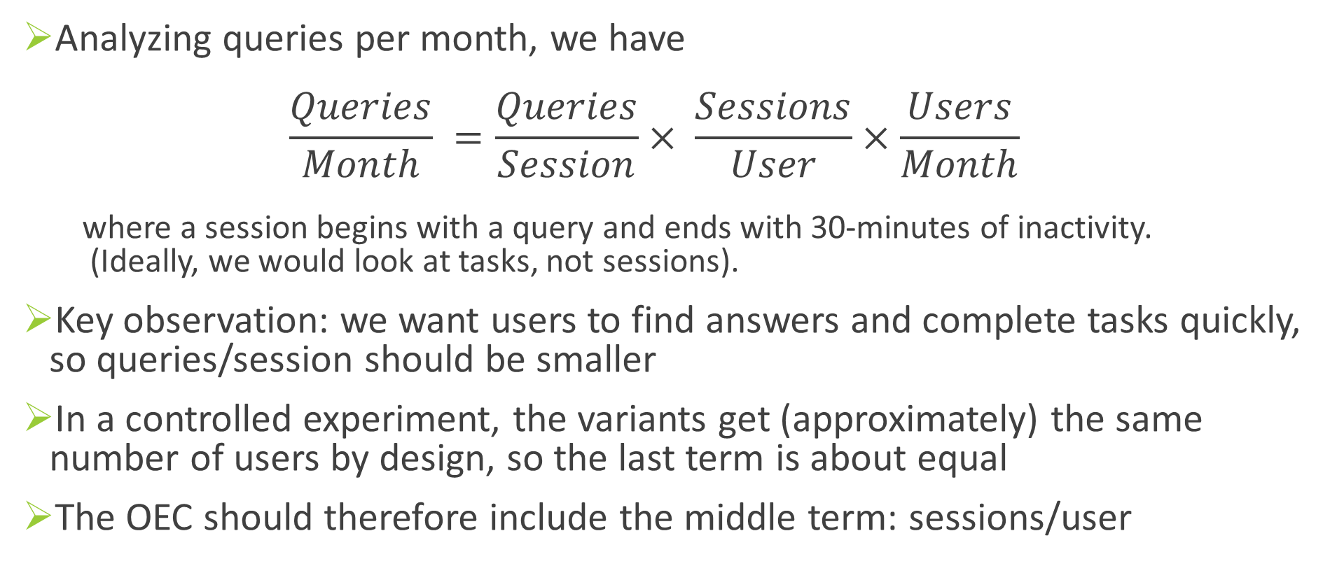
Puzzle Explained
Analyzing queries per month, we have $\frac{Queries}{Month} =\frac{Queries}{Session}× \frac{Sessions}{User}×\frac{Users}{Month}$
where a session begins with a query and ends with 30-minutes of inactivity. (Ideally, we would look at tasks, not sessions).
Key observation: we want users to find answers and complete tasks quickly, so queries/session should be smaller
In a controlled experiment, the variants get (approximately) the same number of users by design, so the last term is about equal
The OEC should therefore include the middle term: sessions/user

Slide 55
Get the Stats Right
Getting numbers is easy; getting numbers you can trust is hard
Two very good books on A/B testing (A/B Testing from Optimizely founders Dan Siroker and Peter Koomen; and You Should Test That by WiderFunnel’s CEO Chris Goward) get the stats wrong (see Amazon reviews).
Optimizely recently updated their stats in the product to correct for this
Best techniques to find issues: run A/A tests
Like an A/B test, but both variants are exactly the same
Are users split according to the planned percentages?
Is the data collected matching the system of record?
Are the results showing non-significant results 95% of the time?

Slide 56
Online is Different than Offline (2)
Key differences from Offline to Online (cont)
Click instrumentation is either reliable or fast (but not both; see paper)
Bots can cause significant skews. At Bing over 50% of traffic is bot generated!
Beware of carryover effects: segments of users exposed to a bad experience will carry over to the next experiment. Shuffle users all the time (easy for backend experiments; harder in UX)
Performance matters a lot! We run “slowdown” experiments.
A Bing engineer that improves server performance by 10msec (that’s 1/30 of the speed that our eyes blink) more than pays for his fully-loaded annual costs.
Every millisecond counts

